Slide 1
Image courtesy of NASA/GSFC

Slide 2
Global Climate Change and Its Impact on the US Midwest
Eugene S. Takle
Professor
Department of Agronomy
Department of Geological and Atmospheric Science
Director, Climate Science Program
Iowa State University
Ames, IA 50011
Executive/Key Management Meeting
Commonwealth Edison
Oakbrook, IL
16 April 2013

Slide 3
Global CO₂ and Mean Temperature
NOAA
February 2013 was the 336 consecutive month with global temperature above the long term average
NASA

Slide 4
Global CO₂ and Mean Temperature
NOAA
February 2013 was the 336 consecutive month with global temperature above the long term average
NASA

Slide 5
2014 National Climate Assessment

Slide 6
2014 National Climate Assessment

Slide 7
http://www.ncdc.noaa.gov/temp-and-precip/time-series/

Slide 8
http://www.ncdc.noaa.gov/temp-and-precip/time-series/

Slide 10
U.S.
2014 National Climate Assessment

Slide 11
U.S.
Decrease in Heating Demand
2014 National Climate Assessment

Slide 12
http://www.ncdc.noaa.gov/temp-and-precip/time-series/

Slide 13
U.S.
Increase in Cooling Demand
2014 National Climate Assessment

Slide 14
~8% increase in 40 years

Slide 16
2014 National Climate Assessment

Slide 17
Daily totals > 4 inches
2014 National Climate Assessment

Slide 18
2014 National Climate Assessment

Slide 19
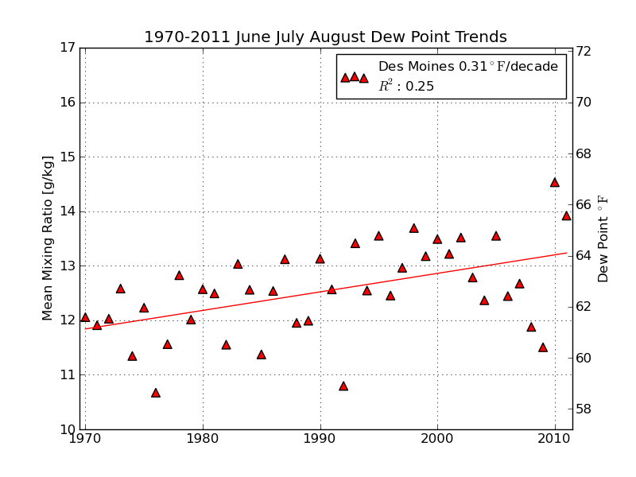
Mean Summer (JJA) Dew-Point Temperatures for Des Moines, IA
Rise of 3ºF in 42 years
12% rise in water content in 42 years
Iowa Environmental Mesonet

Slide 20
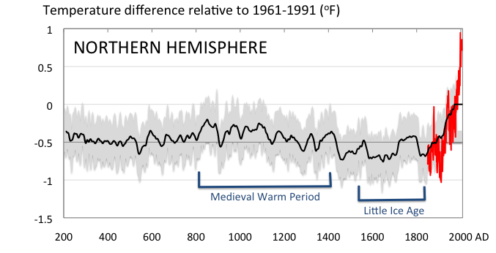
Conditions today are unusual in the context of the last 2,000 years …
Don Wuebbles

Slide 21
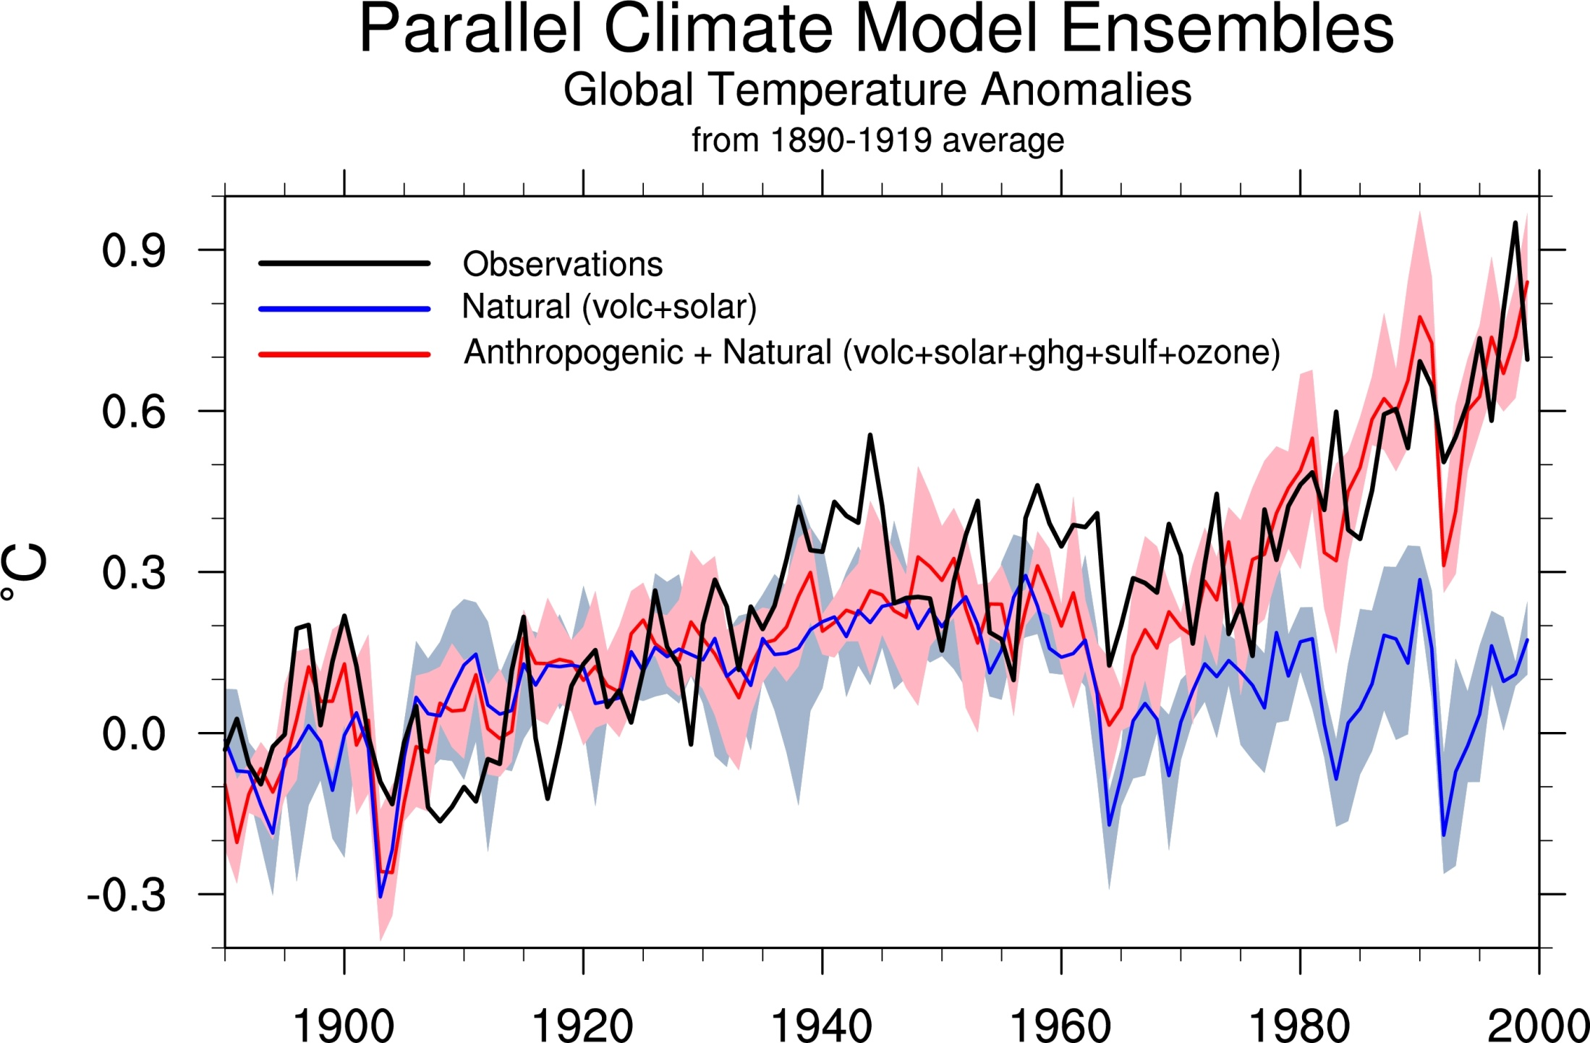
Climate models: Natural processes do not account for
observed 20th century warming after 1965
Gerald Meehl

Slide 22
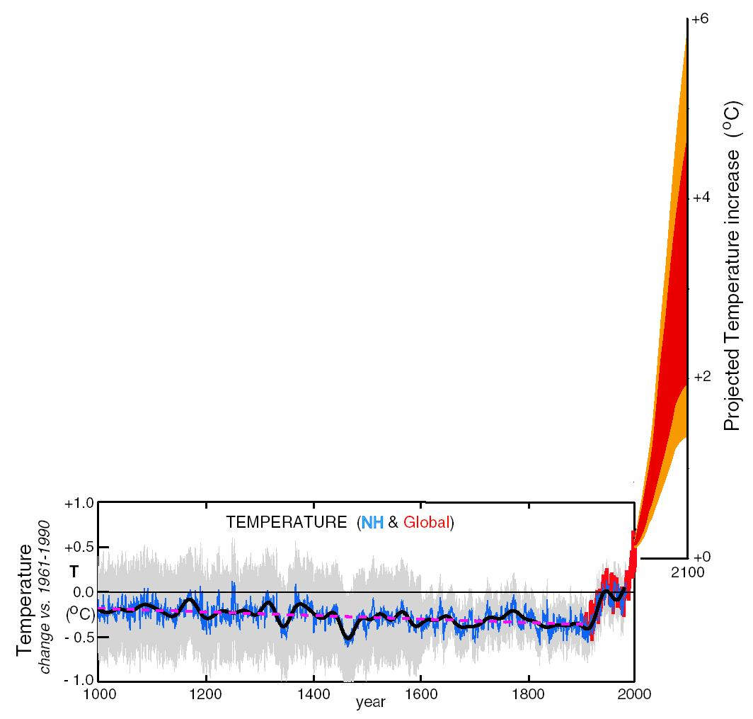
What can we expect in the future?
Don Wuebbles

Slide 23
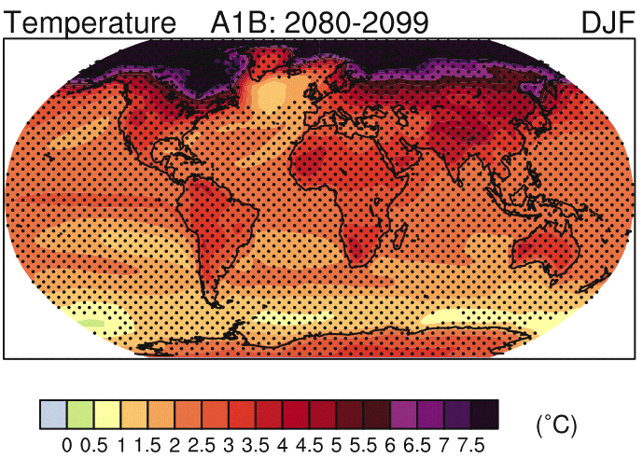
IPCC 2007

Slide 24
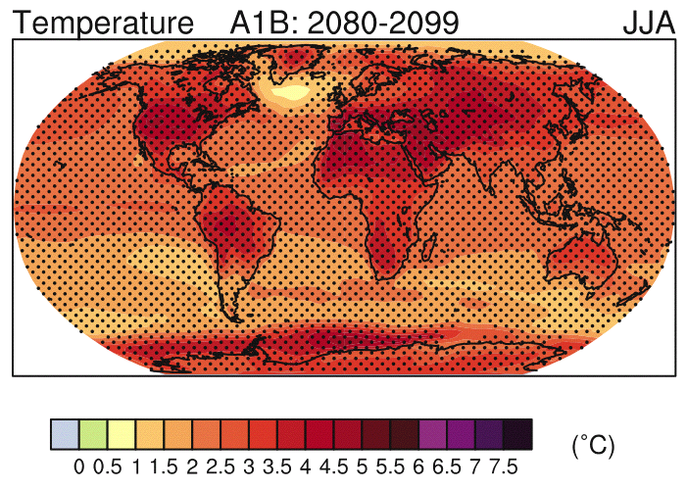
IPCC 2007

Slide 25
2014 National Climate Assessment

Slide 26
Midwest Examples
April 2012: Below freezing temperatures
March 2012: Record high temperature
Impact: 85% loss of fruit crop
2014 National Climate Assessment

Slide 27
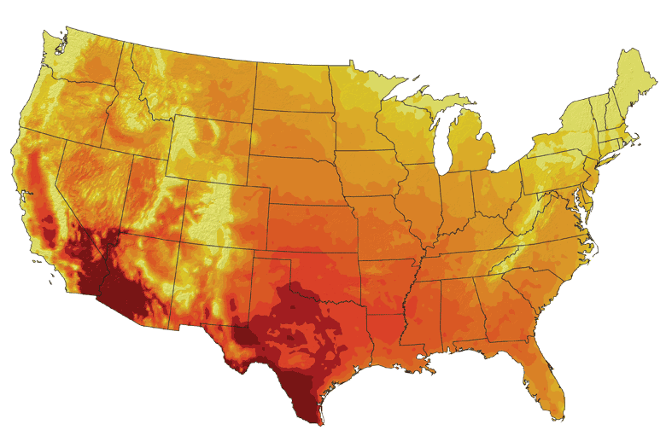
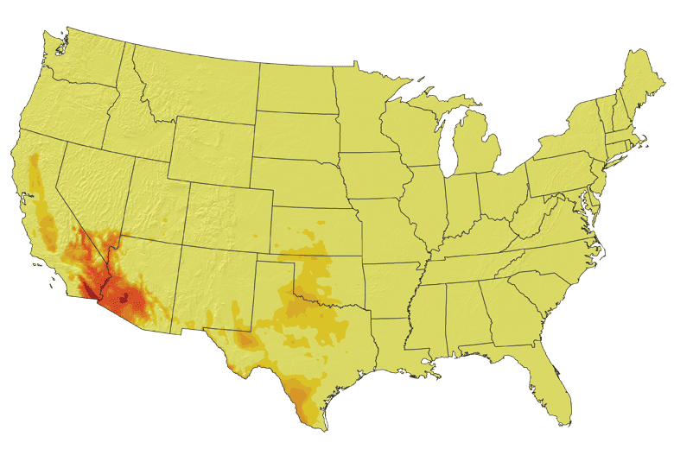
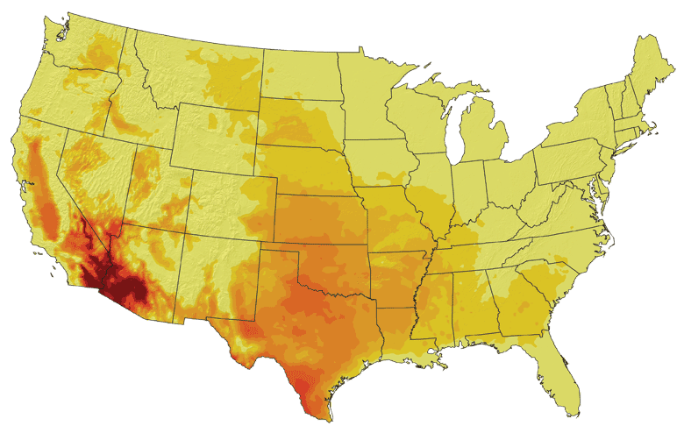
Increases in very high temperatures will have
wide-ranging effects
Higher Emissions Scenario, 2080-2099
Number of Days Over 100ºF
Recent Past, 1961-1979
Average:
30-60 days
Lower Emissions Scenario, 2080-2099
Average:
< 10 days
Average:
10-20 days
Don Wuebbles

Slide 28
Chicago: 750 deaths in 5 days
2014 National Climate Assessment

Slide 29
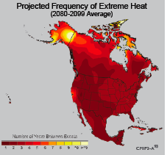
Extreme weather events become more common
Events now considered rare will become commonplace.
Heat waves will likely become longer and more severe
Droughts are likely to become more frequent and severe in some regions
Likely increase in severe thunderstorms (and perhaps in tornadoes).
Winter storm tracks are shifting
northward and the strongest storms are
likely to become stronger and more
frequent.
Don Wuebbles
Notes:
Shown here is the frequency at the end of the century of what we consider now to be a 20 year heat wave. Instead of once every 20 years, these temperatures would be experienced every other year or so over most of the continental US in this business as usual scenario.

Slide 30
2014 National Climate Assessment

Slide 31
2014 National Climate Assessment

Slide 32
Iowa State-Wide Average Data
Totals above 40”
3 years
5 years
5 years
7 years
2012
Totals below 25”

Slide 33
Iowa State-Wide Average Data
Totals above 40”
3 years
5 years
2012
1990-2011: lack of drought

Slide 34
Des Moines Airport Data
1983: 13
11 days in 2012
1988: 10
1977: 8
1974: 7
6 days ≥ 100ºF in 23 years

Slide 35
2014 National Climate Assessment

Slide 36
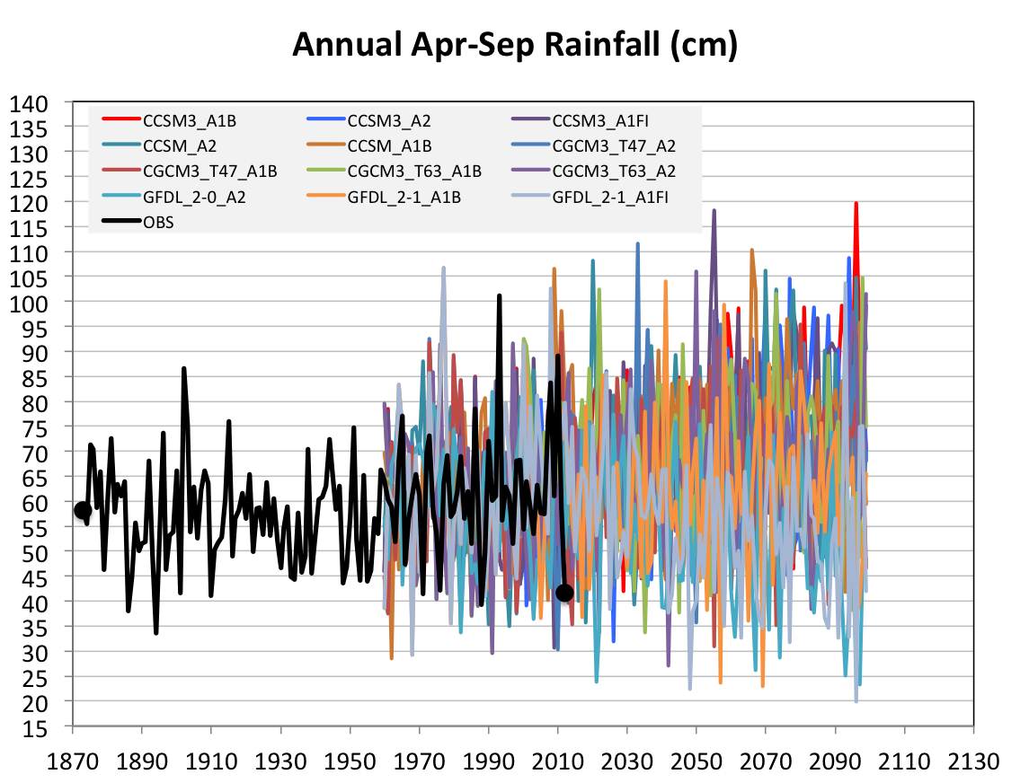
Future Variability in Growing Season Precipitation for Iowa
More intense rain events
More extreme droughts
CJ Anderson, ISU

Slide 37
Future Variability in Growing Season Precipitation for Iowa
More intense rain events
Lines drawn by eye
More extreme droughts
CJ Anderson, ISU

Slide 39
How will climate change impact building energy use in Chicago?
Use Energy Plus v. 7.2 building energy simulation model (DOE)
Use multiple realizations of the climate of 2050 by multiple combinations of global and regional climate models
Use multiple building types (e.g., medium office, secondary school, stand-alone retail)
Calculate the change in average energy use between two 30-year periods (1971-2000 and 2041-2070)

Slide 40
Projected Energy Changes, Chicago
Three different model scenarios
Calculations by Shannon Patton
40-70% increase by mid-century, much due to increased humidity
Energy Plus has 16 building types

Slide 41
Take-Away Messages
Temperature trends in NE Illinois generally follow global trends with sustained rapid increases since 1970
Global climate models well calibrated on the early 20th C cannot explain recent global temperature increases without including human effects
Mean temperatures will continue to increase over the current century
Year-to-year changes in summer precipitation will increase
This will lead to higher year-to-year changes in temperature
More intense rain events will lead to more flooding events (and possibly more lightning, strong winds, my speculation)
NE Illinois will experience a seasonal shift and overall decrease in building energy use (absent advances in building design)

Slide 42
For More Information:
Climate Science Program
Iowa State University
http://climate.engineering.iastate.edu/
http://www.meteor.iastate.edu/faculty/takle/
gstakle@iastate.edu
Questions?

